Slide 1
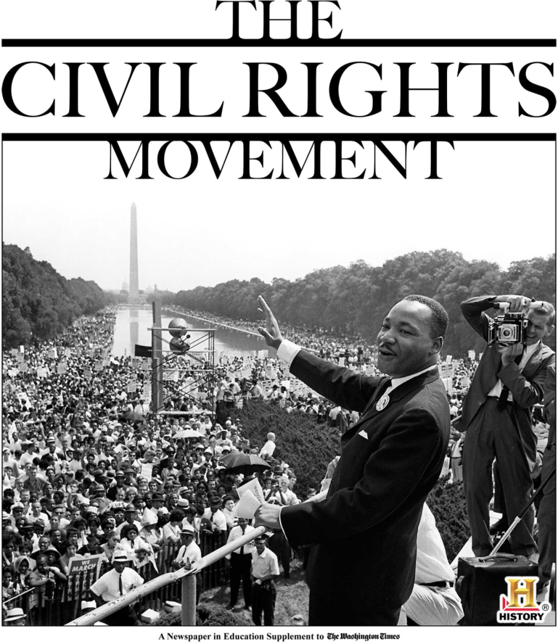
The Civil Rights Movement in Virginia
VS.9c

Slide 2
Civil Rights Movement
In the 1940s and 1950s, African Americans began to demand equal treatment and recognition of their rights as American citizens. This struggle was known as the Civil Rights Movement.
Because of this movement, laws were passed that made racial discrimination illegal.
Racial discrimination is treating people differently because of their race.

Slide 3
Questions
What did African Americans begin to demand?
equal treatment and recognition of their rights as American citizens
What was the Civil Rights Movement?
The struggle for equal treatment
What happened as a result of this movement?
laws were passed that made racial discrimination illegal
What is racial discrimination?
treating people differently because of their race.

Slide 4
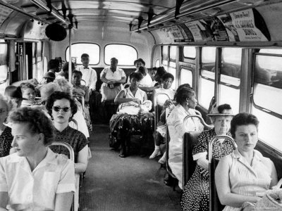
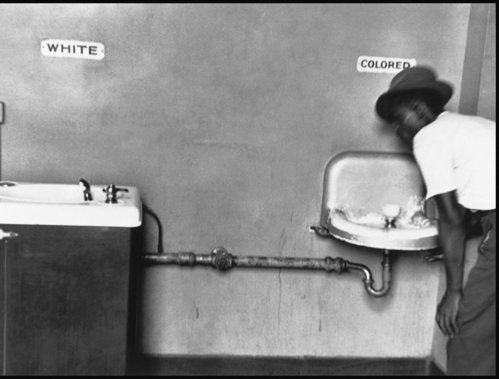
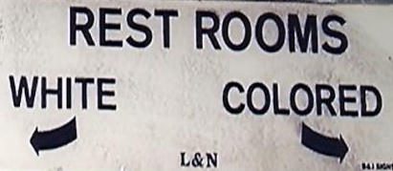
Segregation
Although slavery had been abolished almost 100 years ago, African Americans still did not have the same rights and freedoms as white Americans. Segregation continued. Segregation is the separation of people usually by race or religion. African Americans were forced to sit in the back of city buses, drink from different water fountains, use different restroom facilities, and attend different schools.

Slide 5
Questions
What continued even though slavery had been abolished for almost 100 years?
Segregation
What is segregation?
the separation of people usually by race or religion.

Slide 6
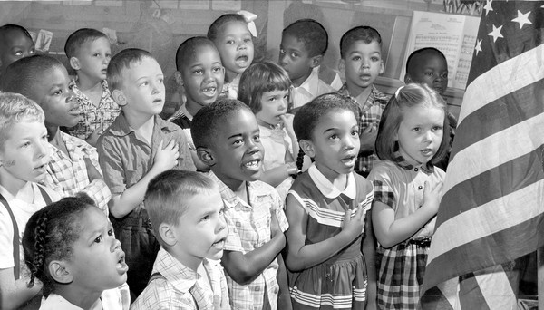
Brown vs. Board of Education
Things began to change in 1954 when the U.S. Supreme Court ruled that “separate but equal” public schools were unconstitutional. This court case was called Brown vs. the Board of Education. Because of this, all public schools were ordered to desegregate.
To desegregate means to abolish or end racial segregation or separateness.

Slide 7
Questions
What did the court case Brown vs. the Board of Education do?
It ruled that “separate but equal” public schools were unconstitutional
Because of this court case, what was Virginia ordered to do?
all public schools were ordered to desegregate
What is desegregation?
to abolish or end racial segregation or separateness

Slide 8
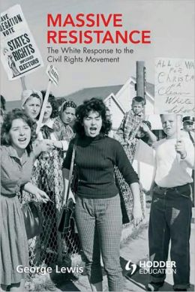
Massive Resistance
Some of Virginia’s leaders did not agree with these new laws that called for desegregation.
Virginia’s government established a policy of Massive Resistance. They fought to “resist” the integration of public schools. Integration means full equality of all races in the use of public facilities.

Slide 9
Questions
Why did Virginia’s government establish a policy of Massive Resistance?
Because they did not agree with the new laws that called for desegregation
What was “Massive Resistance?”
The fight to “resist” the integration of public schools
What is integration?
Full equality of all races in the use of public facilities.

Slide 10
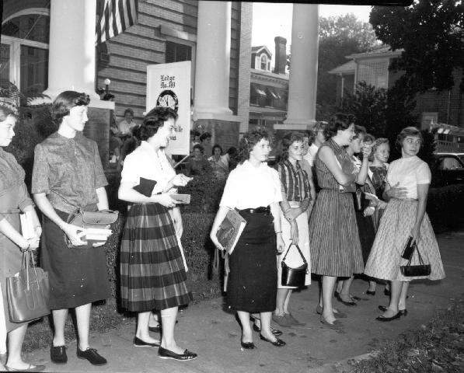
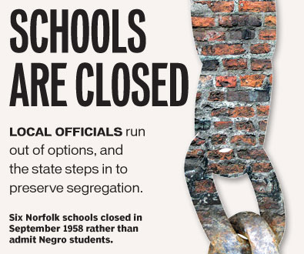
Schools Close
Virginia Senator Harry F. Byrd, Sr. led a Massive Resistance Movement against desegregation of public schools that forced the governor of Virginia to close any school that followed the Supreme Court order. Between 1958 and 1959 some public schools were closed to avoid integration.
← These high school age girls made a “makeshift” school so they would not have to attend school with African Americans

Slide 11
Questions
What did Virginia Senator Harry F. Byrd, Sr. do?
led a Massive Resistance Movement against desegregation
What did the Massive Resistance Movement force the governor of Virginia to do?
close any school that followed the Supreme Court order
What happened to some of the public schools in Virginia during this time?
some public schools were closed to avoid integration.

Slide 12
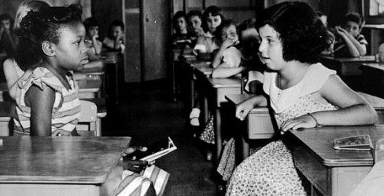
Massive Resistance Failed
By 1959 the Virginia Supreme Court had outlawed school closings. The policy of Massive Resistance had failed. Slowly, Virginia’s public schools were desegregated (integrated).

Slide 13
Questions
What did the Supreme Court do by 1959?
outlawed school closings
What had failed?
the policy of Massive Resistance
What happened to public schools in Virginia after the court’s ruling?
The were slowly desegregated (integrated)

